Slide 1
DGEobj: An R object to capture DGE Workflows
John Thompson
Translational Bioinformatics
16May2019

Slide 2
DGEobj Overview
The DGEobj package defines a data structure that extends the concept of the ExpressionSet and Summarized Experiment to support capture of downstream workflow results
Key Features:
Painlessly enforces a standard data structure
Captures intermediate outputs
Captures project metadata (as attributes)
Captures parent-child relationship of contained data objects
Square bracket subsettable; easy filtering of genes/samples
Accessor functions to build and access data in DGEobj format
Convert to/from ES and SE data structures
Input data from Xpress, Omicsoft, text files
Plug and play into GECO (shiny app) resource
Facilitates data sharing and automated meta-analysis

Slide 3
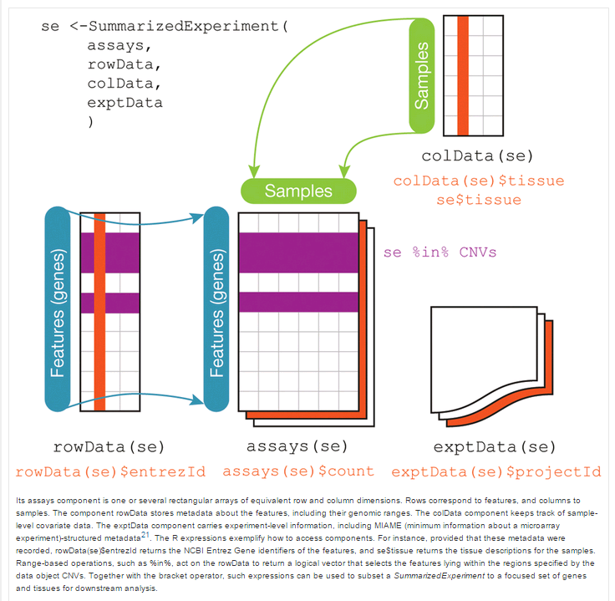
Summarized Experiment structure
SE and ES
limited to 1 each rowData and colData elements
No parent-child relationship
DGEobj removes those limitations and introduces parent-child relationships

Slide 4
DGEobj Engineering
While the DGEobj inherits features from the ES and RSE data structures, it is not an extension of those S4 object.
The DGEobj (an S3 object) is fundamentally a list of data objects (e.g. counts, gene annotation, sample annotation, design matrix, fit object, etc).
We store information about the data objects as R attributes on the DGEobj. In some cases individual elements have attributes as well.
Project level metadata is also captured in attributes (e.g. TBio owner, genome version, gene model, git repo url, etc)

Slide 5
DGE.Tools2 Package
Wrapper around DGEobj
Insures consistent annotation
Implements Limma/Voom DGE workflow
voom with quality weights
Duplicate Correlation
Surrogate Variable Analysis
Easily extensible
Provides assorted plotting tools for common plots (ggplot)
Codifies best practices for DGE analysis

Slide 6
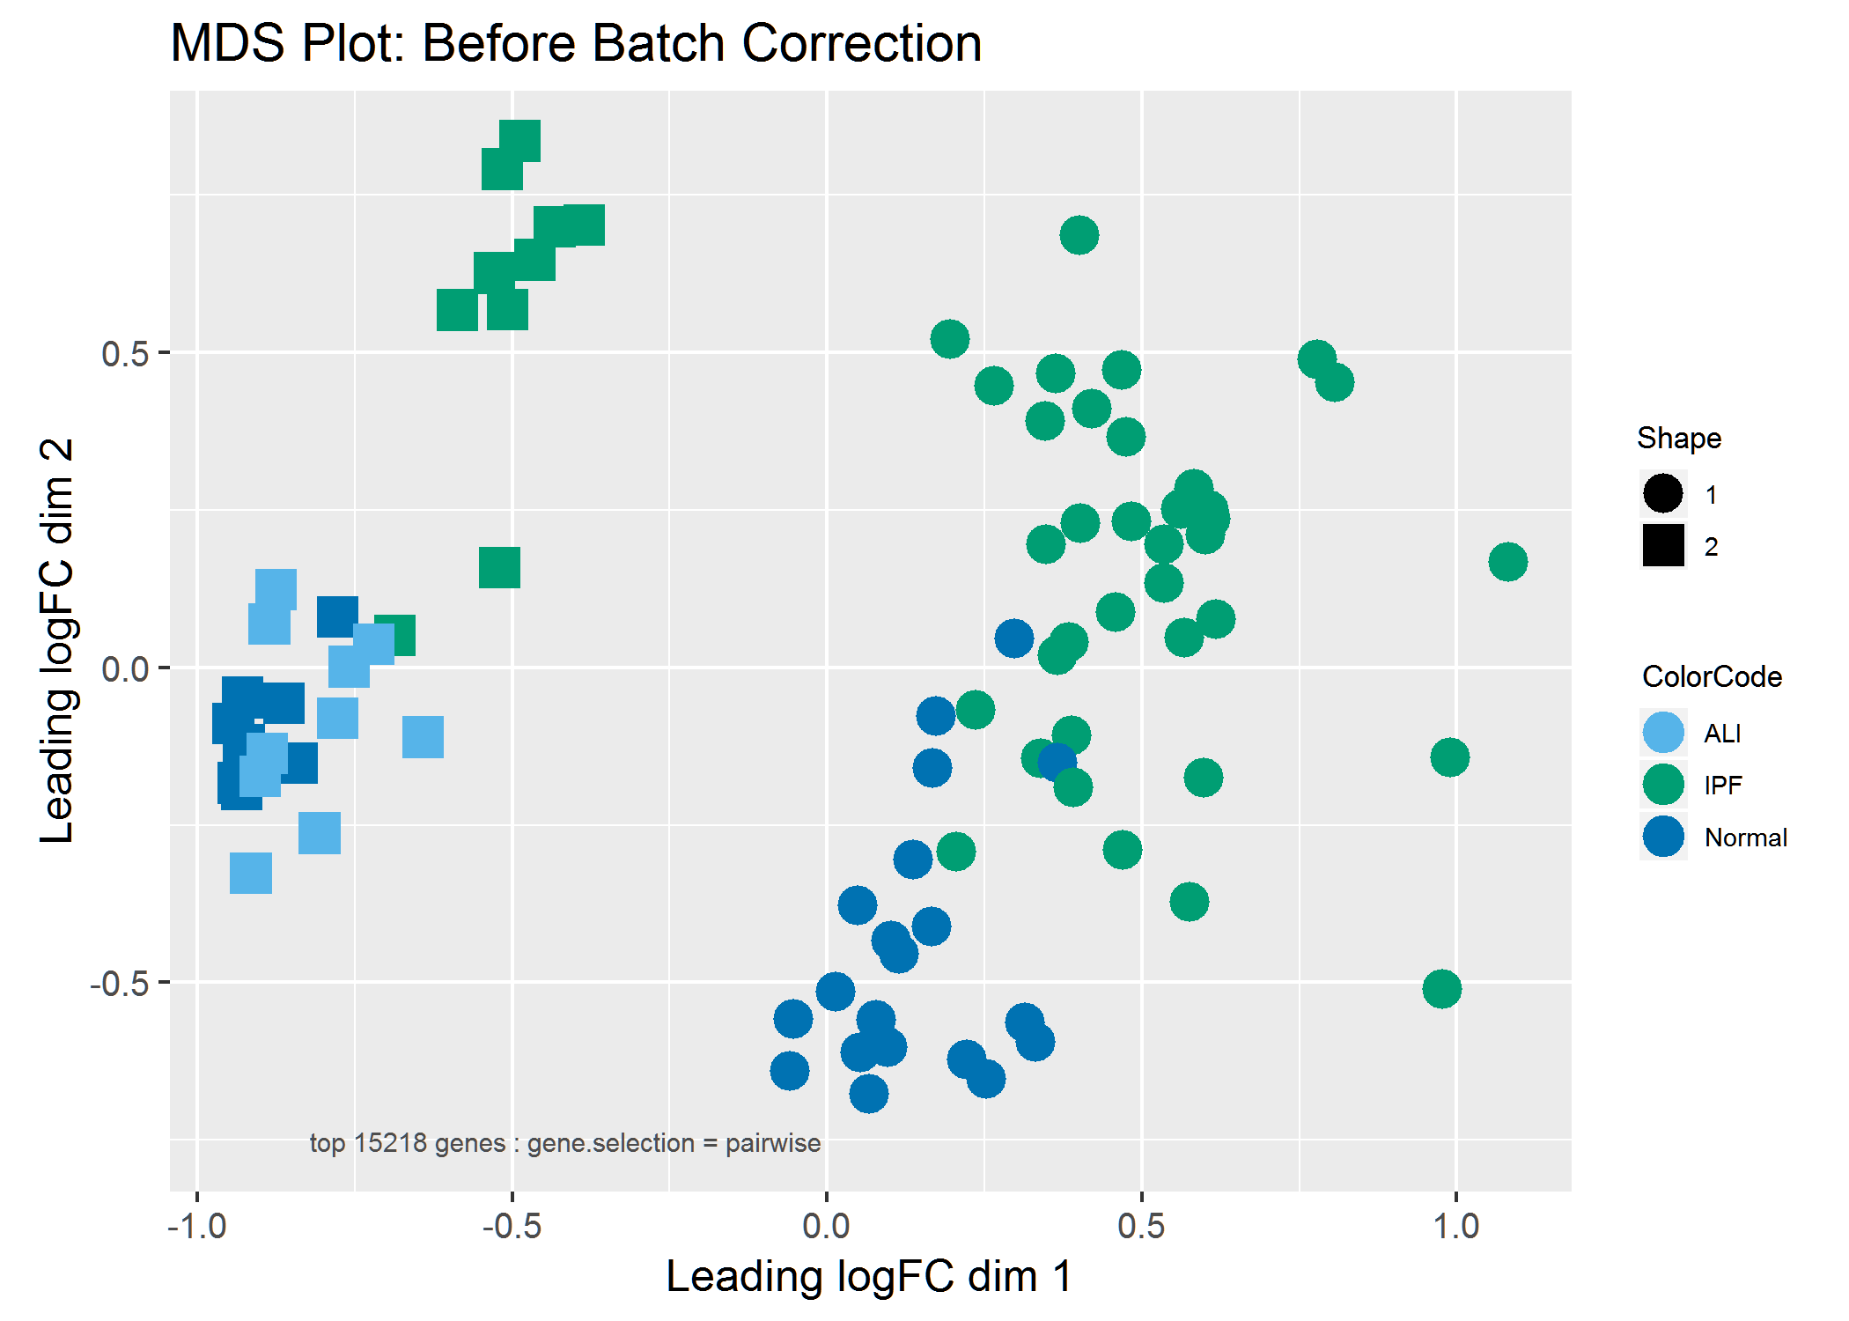
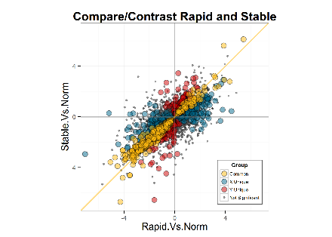
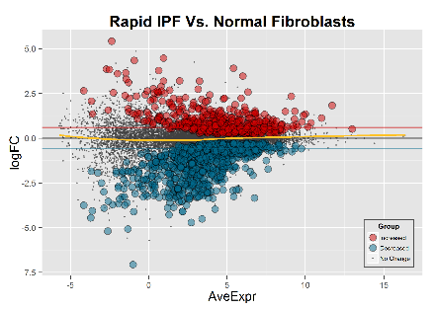
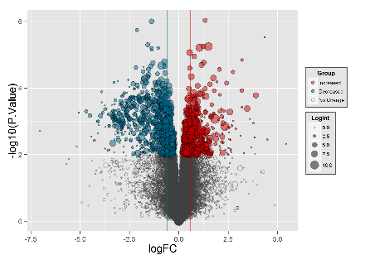
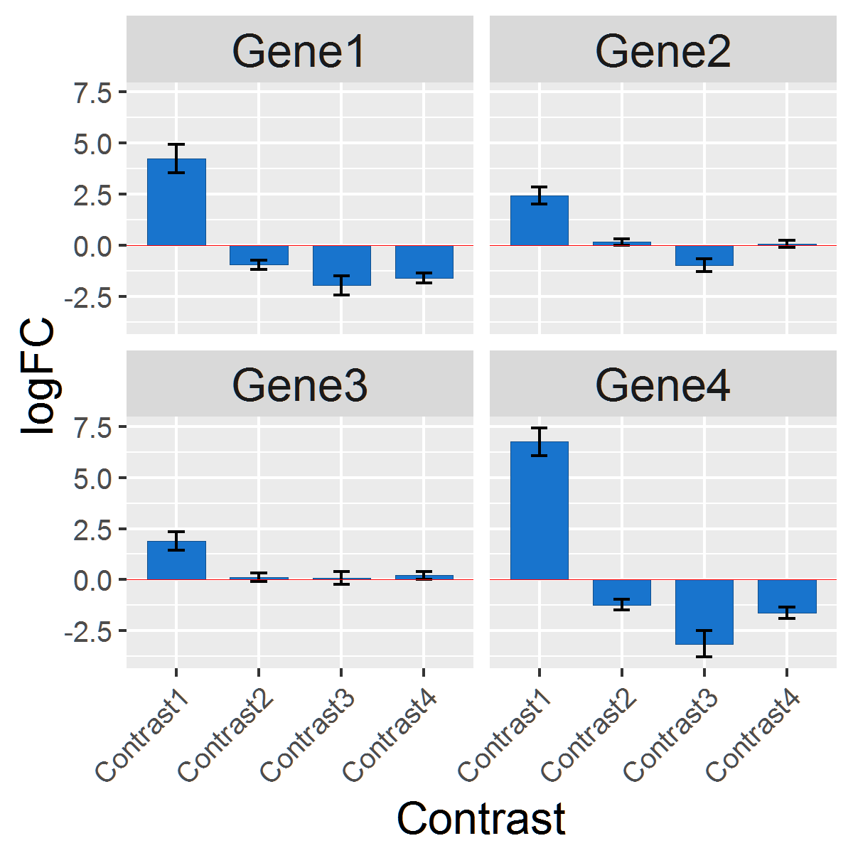
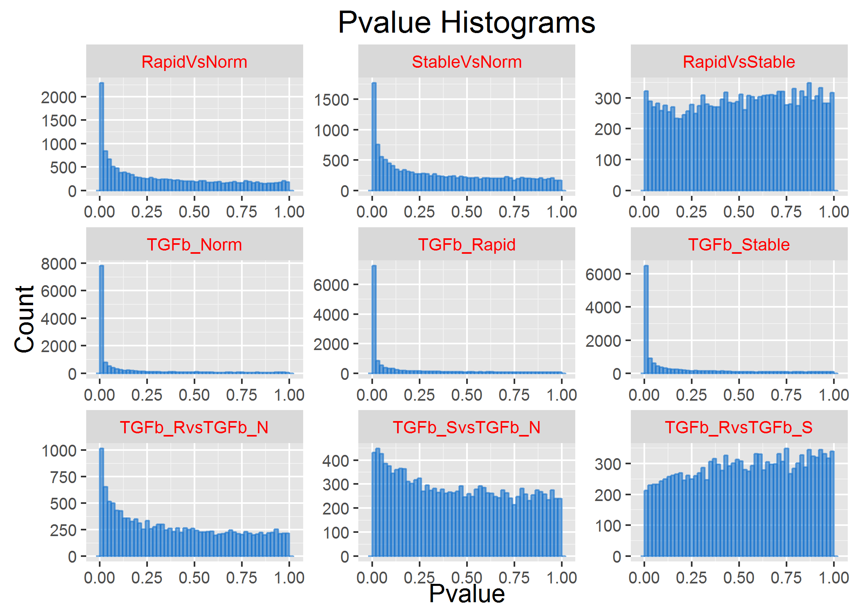
DGE.Tools2 Plotting Functions
runContrasts
DGEobj
MDS Plot
plotDispersion
comparePlot
ggplotMDS
Plot Tools
plotPvalHist
profilePlot
volcanoPlot
profilePlot
volcanoPlot
cdfPlot
obsPlot
comparePlot
GOI Plots
LogRatio GOI
plotPvalHist

